Slide 1
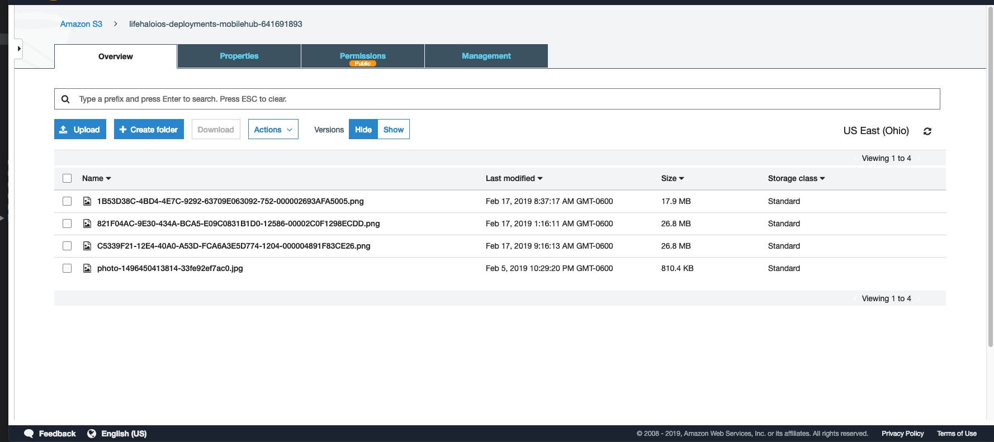
Edward – Week 3 (1)
This past week consisted of moving S3 functionality from the photo controller to the missing person form to prepare for downloading and uploading of photos to and from the form.
Had to change S3 security policy and add Amazon Cognito service es

Slide 2
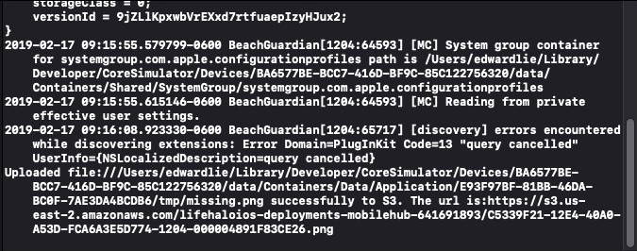
Edward – Week 3 (2)
End goal was to grab URL of link that photo is being saved at. This will be saved in the database.
Activity monitor added.
Constraints for buttons added to make sure the image view is within the bounds of the designated space.

Slide 3
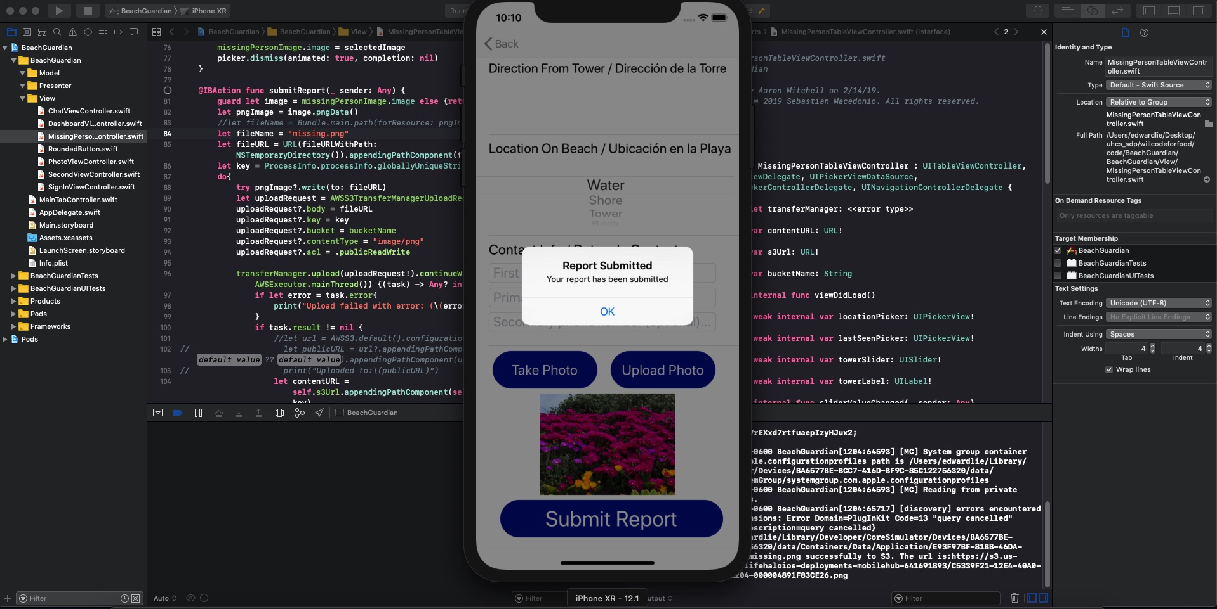
Edward – Week 3 (3)
The submit button saves information to an S3 bucket I created. Information will ultimately be saved to AWS RDS as well through EC2.
My week 4 goal is to create unit tests for newly created functions making sure that code coverage is kept as high as possible.

